Slide 1
MSBD 5018 - Natural Language Processing
Word Embeddings
Instructor: Yangqiu Song
Slides credits: Richard Socher, Vagelis Hristidis

Slide 2
What do words mean?
First thought: look in a dictionary
http://www.oed.com/

Slide 3
Words, Lemmas, Senses, Definitions
lemma
sense
definition

Slide 4
Lemma pepper
Sense 1: spice from pepper plant
Sense 2: the pepper plant itself
Sense 3: another similar plant (Jamaican pepper)
Sense 4: another plant with peppercorns (California pepper)
Sense 5: capsicum (i.e. chili, paprika, bell pepper, etc)

Slide 5
There are relations between senses
Synonymy
Antonymy
Similarity
…

Slide 6
Relation: Synonymy
Synonyms have the same meaning in some or all contexts.
couch / sofa
big / large
automobile / car
water / H₂0

Slide 7
Relation: Antonymy
Senses that are opposites with respect to one feature of meaning
Otherwise, they are very similar!
dark/light short/long fast/slow rise/fall
hot/cold up/down in/out
More formally: antonyms can
define a binary opposition or be at opposite ends of a scale
long/short, fast/slow
Be reversives:
rise/fall, up/down

Slide 8
Relation: Similarity
Words with similar meanings. Not synonyms, but sharing some element of meaning
car, bicycle
cow, horse

Slide 9
Ask humans how similar 2 words are
word1 | word2 | similarity
vanish | disappear | 9.8
behave | obey | 7.3
belief | impression | 5.95
muscle | bone | 3.65
modest | flexible | 0.98
hole | agreement | 0.3
SimLex-999 dataset (Hill et al., 2015)

Slide 10
Relation: Word relatedness
Also called "word association"
Words be related in any way, perhaps via a semantic frame or field
car, bicycle: similar
car, gasoline: related, not similar
Similarity is a specific type of relatedness: graded
car vs. automobile -> 1.0
car vs. vehicle -> 0.6
car vs. tire -> 0.2
car vs. street -> 0.1
Similarity: synonyms, hyponyms/hyperonyms, and siblings are highly similar
doctor vs. surgeon, bike vs. bicycle
Relatedness: topically related or based on any other semantic relation
heart vs. surgeon, tire vs. car

Slide 11
Relation: Superordinate/ subordinate
One sense is a subordinate (subclass, hyponym) of another if the first sense is more specific, denoting a subclass of the other
car is a subordinate of vehicle
mango is a subordinate of fruit
Conversely superordinate (superclass, hypernym)
vehicle is a superordinate of car
fruit is a superordinate of mango
Superordinate | vehicle | fruit | furniture
Subordinate | car | mango | chair

Slide 12
Some Other Relations
Member holonym/meronym (groups and members)
professor is a member meronym of (a university’s) faculty
Part holonym/meronym (wholes and parts)
wheel is a part meronym of (is a part of) car.
Substance meronym/holonym (substances and components)
flour is a substance meronym of (is made of) bread
Entailment (between events):
snore/sleep
Snoring entails (presupposes) sleeping

Slide 13
What is the computational approach to evaluate word similarities/relatedness?

Slide 14
Computational Approaches
Knowledge base based
WordNet Similarity
…
Corpus based
Distributional similarity
Deep learning

Slide 15
Corpus based Approach
Distributional semantics
The basic idea of distributional semantics can be summed up in the so-called distributional hypothesis: linguistic items with similar distributions have similar meanings.
You shall know a word by the company it keeps." (Firth (1957))
The distributional hypothesis in linguistics is derived from the semantic theory of language usage, i.e. words that are used and occur in the same contexts tend to purport similar meanings.
Distributional hypothesis: Semantically similar words occur in similar contexts (Harris (1954))
We will mention distributed representation based neural language models in this class

Slide 16
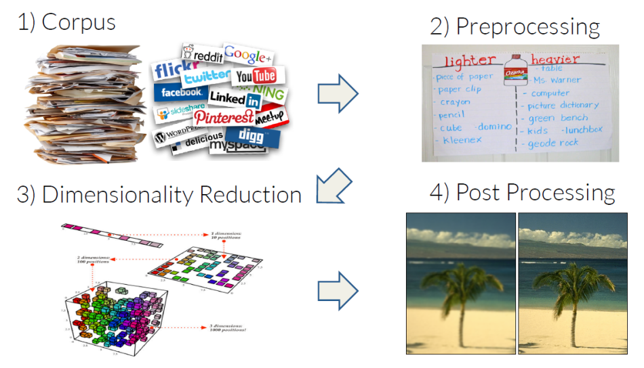
Corpus based Approach

Slide 17
Let's try to keep the kitchen .
Observation: context can tell us a lot about word meaning
Context: local window around a word occurrence (for now)
Pros: data-driven, easy to implement
Cons: ambiguity

Slide 18
Window based co-occurrence matrix
Window length 1 (more common: 5 - 10)
Symmetric (irrelevant whether left or right context)
Example corpus:
I like deep learning.
I like NLP.
I enjoy flying.

Slide 19
Window based co-occurrence matrix
Example corpus:
I like deep learning.
I like NLP.
I enjoy flying.

Slide 20
Problems with simple co-occurrence vectors
Increase in size with vocabulary
Very high dimensional: require a lot of storage
Subsequent classification models have sparsity issues
→Models are less robust

Slide 21
Solution: Low dimensional vectors
Idea: store “most” of the important information in a fixed, small number of dimensions: a dense vector
Usually around 25 – 1000 dimensions
How to reduce the dimensionality?

Slide 22
Method 1: Dimensionality Reduction on X
Singular Value Decomposition of co-occurrence matrix X.
best rank k approximation to X , in terms of least squares.

Slide 23
Simple SVD word vectors in Python
Corpus:
I like deep learning. I like NLP. I enjoy flying.

Slide 24
Simple SVD word vectors in Python
Corpus: I like deep learning. I like NLP. I enjoy flying.
Printing first two columns of U corresponding to the 2 biggest singular values

Slide 25
Word meaning is defined in terms of vectors
In most deep learning models, a word is represented as a dense vector

Slide 26
Hacks to X
Problem: function words (the, he, has) are too frequent → syntax has too much impact. Some fixes:
min(X,t), with t~100
Ignore them all
Ramped windows that count closer words more
Use Pearson correlations instead of counts, then set negative values to 0

Slide 27
Interesting semantic patters emerge in the vectors
An Improved Model of Semantic Similarity Based on Lexical Co-Occurrence (Rohde et al. 2005)

Slide 28
Interesting semantic patters emerge in the vectors
An Improved Model of Semantic Similarity Based on Lexical Co-Occurrence (Rohde et al. 2005)

Slide 29
Interesting semantic patters emerge in the vectors
An Improved Model of Semantic Similarity Based on Lexical Co-Occurrence (Rohde et al. 2005)

Slide 30
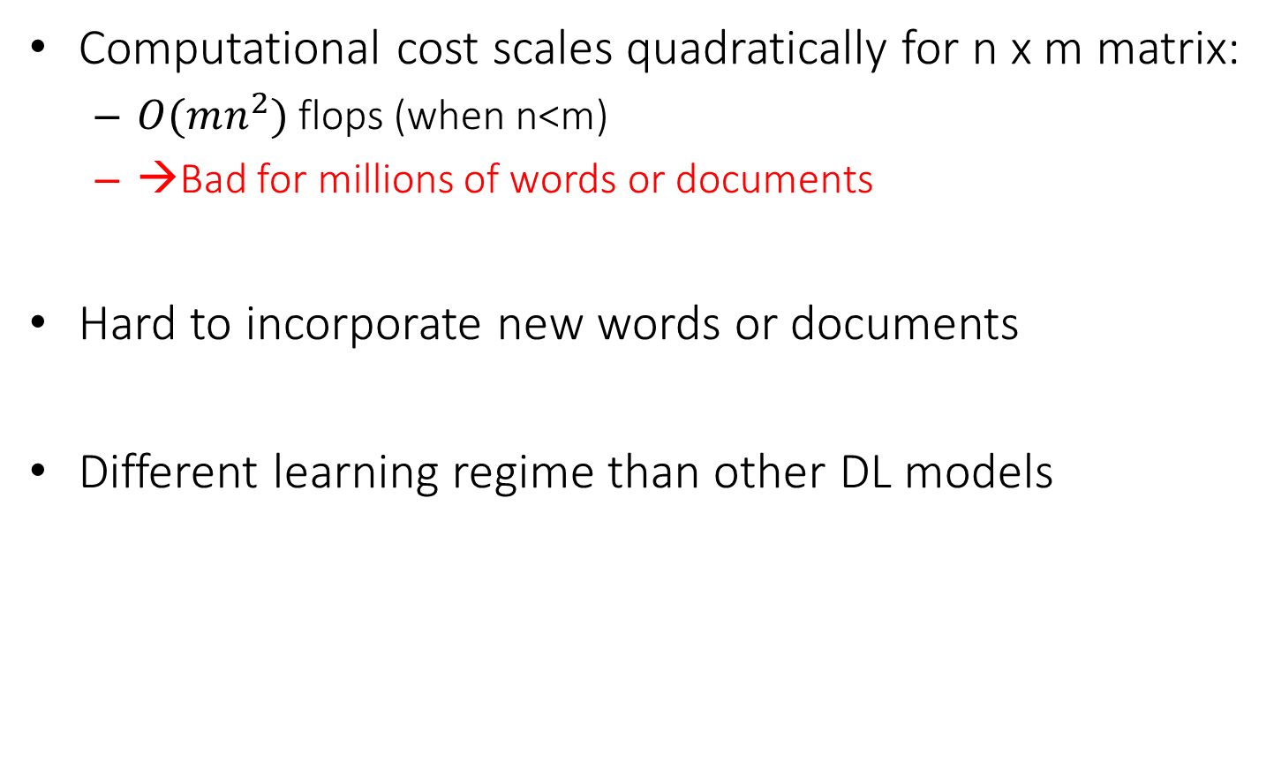
Problems with SVD
Computational cost scales quadratically for n x m matrix:
$O(mn^{2})$ flops (when n<m)
→Bad for millions of words or documents
Hard to incorporate new words or documents
Different learning regime than other DL models

Slide 31
Idea: Directly learn low-dimensional word vectors
Old idea. Relevant for this lecture & deep learning:
Learning representations by back-propagating errors. (Rumelhart et al., 1986)
A neural probabilistic language model (Bengio et al., 2003)
Multilayer perceptron
NLP (almost) from Scratch (Collobert & Weston, 2008)
CNN
An even simpler and faster model:
word2vec (Mikolov et al. 2013) → intro now

Slide 32
Distributed Representations
This is usually called distributed representations in the context of deep learning
Vector representation does not represent a distribution, but distributed over the space
Term widely used in connectionism (Learning distributed representations of concepts, Hinton (1986))
“In the componential approach each concept is simply a set of features and so a neural net can be made to implement a set of concepts by assigning a unit to each feature and setting the strengths of the connections between units so that each concept corresponds to a stable pattern of activity distributed over the whole network.”
Compared to distributional semantics
The distributional hypothesis in linguistics is derived from the semantic theory of language usage, i.e. words that are used and occur in the same contexts tend to purport similar meanings.

Slide 33
Main Idea of word2vec
Instead of capturing co-occurrence counts directly,
Predict surrounding words of every word
Faster and can easily incorporate a new sentence/document or add a word to the vocabulary

Slide 34
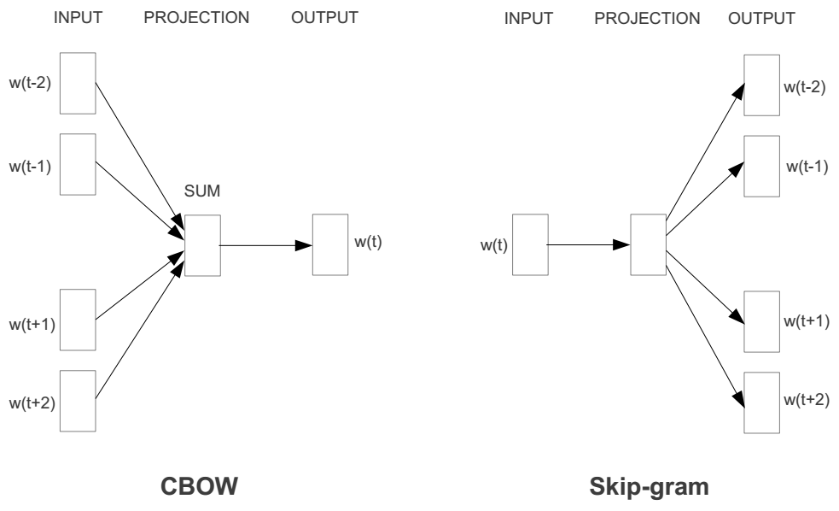
Represent the meaning of word – word2vec
2 basic neural network models:
Continuous Bag of Word (CBOW): use a window of word to predict the middle word
Skip-gram (SG): use a word to predict the surrounding ones in window.

Slide 35
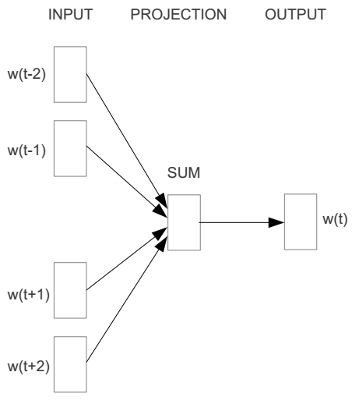
Word2vec – Continuous Bag of Word
E.g. “The cat sat on floor”
Window size = 2
the
cat
sat
on
floor

Slide 36
Input layer
Index of cat in vocabulary
0
1
0
cat
0
Hidden layer
Output layer
0
0
0
0
0
0
…
0
0
0
one-hot
vector
0
sat
one-hot
vector
0
0
0
0
1
0
…
1
0
on
0
0
0
0
…
0

Slide 37



We must learn W and W’
Input layer
0
1
0
cat
0
$$W_{V×N}$$
Hidden layer
Output layer
0
0
0
0
0
0
V-dim
…
0
0
$${W′}_{N×V}$$
0
0
sat
0
0
0
0
1
0
$$W_{V×N}$$
N-dim
…
V-dim
1
0
on
0
0
0
0
V-dim
…
N will be the size of word vector
0

Slide 38
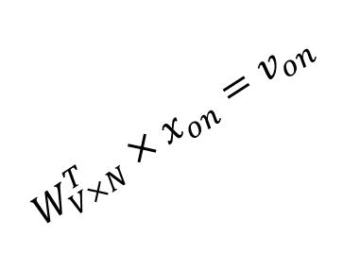

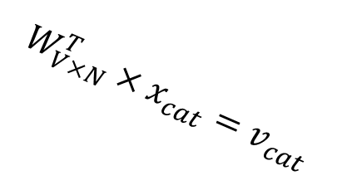



$$W_{V×N}^{T} ×x_{cat}=v_{cat}$$
0.1 | 2.4 | 1.6 | 1.8 | 0.5 | 0.9 | … | … | … | 3.2
0.5 | 2.6 | 1.4 | 2.9 | 1.5 | 3.6 | … | … | … | 6.1
… | … | … | … | … | … | … | … | … | …
… | … | … | … | … | … | … | … | … | …
0.6 | 1.8 | 2.7 | 1.9 | 2.4 | 2.0 | … | … | … | 1.2
0
2.4
2.6
…
…
1.8
Input layer
1
$$×$$
0
$$=$$
0
0
1
0
0
0
x_{cat}
0
0
Output layer
0
0
0
$$W_{V×N}^{T}×x_{cat}=v_{cat}$$
…
0
0
0
0
0
V-dim
…
0
0
$$\hat{v}=\frac{v_{cat}+v_{on}}{2}$$
0
+
0
sat
0
0
0
0
$$W_{V×N}^{T}×x_{on}=v_{on}$$
1
0
…
V-dim
1
Hidden layer
0
x_{on}
0
0
N-dim
0
0
V-dim
…
0

Slide 39

$$W_{V×N}^{T} ×x_{on}=v_{on}$$
0.1 | 2.4 | 1.6 | 1.8 | 0.5 | 0.9 | … | … | … | 3.2
0.5 | 2.6 | 1.4 | 2.9 | 1.5 | 3.6 | … | … | … | 6.1
… | … | … | … | … | … | … | … | … | …
… | … | … | … | … | … | … | … | … | …
0.6 | 1.8 | 2.7 | 1.9 | 2.4 | 2.0 | … | … | … | 1.2
0
1.8
2.9
…
…
1.9
Input layer
0
$$×$$
0
$$=$$
0
1
1
0
0
0
x_{cat}
0
0
Output layer
0
0
0
$$W_{V×N}^{T}×x_{cat}=v_{cat}$$
…
0
0
0
0
0
V-dim
…
0
0
$$\hat{v}=\frac{v_{cat}+v_{on}}{2}$$
0
+
0
sat
0
0
0
0
$$W_{V×N}^{T}×x_{on}=v_{on}$$
1
0
…
V-dim
1
Hidden layer
0
x_{on}
0
0
N-dim
0
0
V-dim
…
0

Slide 40






Input layer
0
1
0
cat
0
$$W_{V×N}$$
Hidden layer
Output layer
0
0
0
0
0
0
V-dim
…
0
0
$$W_{V×N}^{′}×\hat{v}=z$$
0
$$\hat{y}=softmax(z)$$
0
0
0
0
0
$$\hat{v}$$
1
0
$$W_{V×N}$$
…
1
N-dim
0
on
0
${\hat{y}}_{sat}$
0
0
V-dim
0
V-dim
…
N will be the size of word vector
0

Slide 41


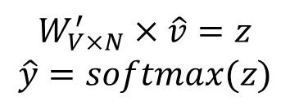
Input layer
0
We would prefer $\hat{y}$ close to ${\hat{y}}_{sat}$
1
0
cat
0
$$W_{V×N}$$
Hidden layer
Output layer
0
0
0
0
0.01
0.02
0.00
0.02
0.01
0.02
0.01
0.7
…
0.00
0
0
V-dim
…
0
0
$$W_{V×N}^{′}×\hat{v}=z$$
$$\hat{y}=softmax(z)$$
0
0
0
0
0
0
$$\hat{v}$$
1
0
$$W_{V×N}$$
…
1
N-dim
0
on
0
${\hat{y}}_{sat}$
0
0
V-dim
0
V-dim
…
N will be the size of word vector
$\hat{y}$
0

Slide 42
$$W_{V×N}^{T}$$
0.1 | 2.4 | 1.6 | 1.8 | 0.5 | 0.9 | … | … | … | 3.2
0.5 | 2.6 | 1.4 | 2.9 | 1.5 | 3.6 | … | … | … | 6.1
… | … | … | … | … | … | … | … | … | …
… | … | … | … | … | … | … | … | … | …
0.6 | 1.8 | 2.7 | 1.9 | 2.4 | 2.0 | … | … | … | 1.2
Contain word’s vectors
Input layer
0
1
0
x_{cat}
0
Output layer
0
0
$$W_{V×N}^{}$$
0
0
0
0
V-dim
…
0
0
$$W_{V×N}^{′}$$
0
0
sat
0
0
0
0
1
0
$$W_{V×N}^{}$$
…
1
0
V-dim
x_{on}
0
Hidden layer
0
N-dim
0
0
V-dim
…
0
We can consider either W or W’ as the word’s representation. Or even take the average.
Notes:
W contains input word vectors.
W’ contains output word vectors.
We can consider either W or W’ as the word’s representation. Or even take the average.

Slide 43
Approximations
With large vocabularies this objective function is not scalable and would train too slowly! → Why?
Idea: approximate the normalization or
Define negative prediction that only samples a few words that do not appear in the context
Similar to focusing on mostly positive correlations
More reading
https://canvas.ust.hk/courses/16504/files/1444107?module_item_id=214783

Slide 44
Linear Relationships in word2vec
These representations are very good at encoding dimensions of similarity!
Analogies testing dimensions of similarity can be solved quite well just by doing vector subtraction in the embedding space
Syntactically
apple − apples ≈ car − cars ≈ family − families
Similarly for verb and adjective morphological forms
Semantically (Semeval 2012 task 2)
shirt − clothing ≈ chair − furniture
king − man ≈ queen − woman

Slide 45
Word Analogies
Test for linear relationships, examined by Mikolov et al. (2014)

Slide 46
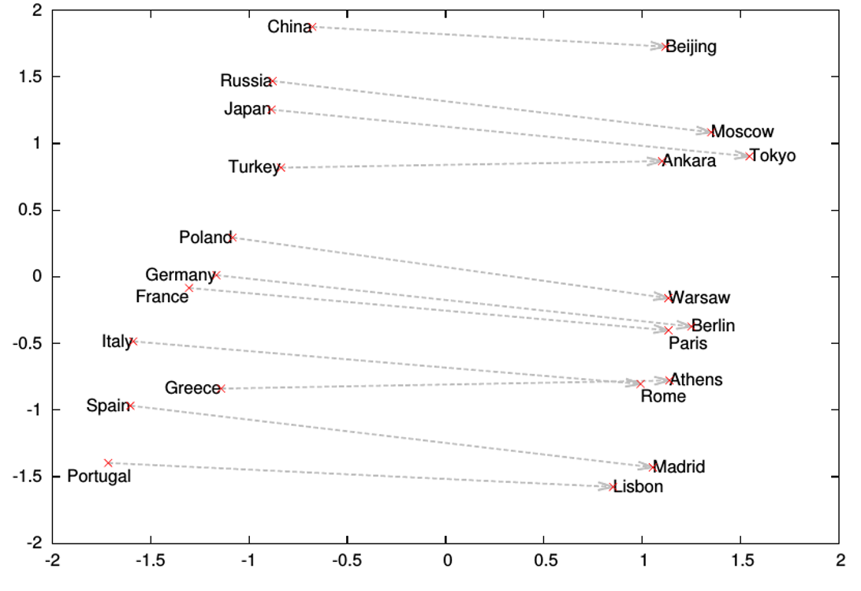
Word analogies

Slide 47
Glove Visualizations

Slide 48
Glove Visualizations: Company - CEO

Slide 49
Glove Visualizations: Superlatives

Slide 50
More Examples
“word2vec Parameter Learning Explained”, Xin Rong
https://ronxin.github.io/wevi/
Word2Vec Tutorial - The Skip-Gram Model
http://mccormickml.com/2016/04/19/word2vec-tutorial-the-skip-gram-model/

Slide 51
Deep Contextualized Word Representation
As most NLP tasks are context related, most of existing methods would contextualize the word embedding before make the final prediction
However, complicated neural models requires extensive training data:
Models pre-trained on the ImageNet are widely used for Computer Vision tasks
What’s the proper way to conduct pre-training for NLP?
Basic Idea
Leveraging Language Modeling to get pre-trained contextualized representation models
Highlight:
1. rely on large corpora, instead of human annotations
2. works very well ---- improve the performance of existing SOA methods a lot
http://aclweb.org/anthology/N18-1202

Slide 52
Experiments
Add ELMo at the input of RNN. For some tasks (SNLI, SQuAD), including ELMo at the output brings further improvements

Slide 53
Google’s BERT
Training of BERT-BASE was performed on 4 Cloud TPUs in Pod configuration (16 TPU chips total).
Training of BERT-LARGE was performed on 16 Cloud TPUs (64 TPU chips total).
Each pre-training took 4 days to complete.
https://ai.googleblog.com/2018/11/open-sourcing-bert-state-of-art-pre.html
https://arxiv.org/pdf/1810.04805.pdf

Slide 54
Experiments

Slide 55
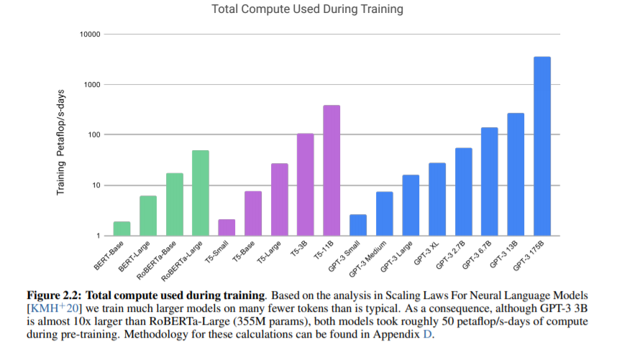
GPT3: A Giant Language Model used for Few-shot Learning

